Slide 1
Blockchain for Humanity

Slide 2
1. Who We Are
“We believe in the power of technology to help transform our lives for the better”
Not-for-profit foundation driven by early blockchain adopters, we sustain our mission through charitable donations.
Our mission is to identify, support, help implement and recognize projects working on Blockchain powered solutions that offer positive impact on humanity
We do this because we believe in the power of emerging technologies to help transform the socio-economic landscape.
With the support of #Coalitions4GOOD we will construct a world and society that is more transparent, fair and inclusive.
Notes:
“We encourage the use of the blockchain technology to develop socio-economic impact solutions within emerging markets.”
Through our b4H CATALIZING PROGRAM and our COALITION 4 GOOD Blockchain Ecosystem of mentors, partners and sponsors, donors; We ignite the use of the technology to reduce gaps in society and build a more equitable life for many.

Slide 3
2. What We Do
“We want to solve real problems affecting humanity”
We support the use of blockchain to improve existing models and encourage new innovative models that offer socio-economic solutions in emerging markets.
Through a Catalizer Program, we channel resources while working closely with projects teams in advancing their concept to reach use case validation, pilot and implementation.
We are protocol agnostic and foster coalitions of partners, mentors, advisors and donors that share the values: inclusive, open-source, transparency and empowerment -- to support the projects.
Notes:
“We encourage the use of the blockchain technology to develop socio-economic impact solutions within emerging markets.”
Through our b4H CATALIZING PROGRAM and our COALITION 4 GOOD Blockchain Ecosystem of mentors, partners and sponsors, donors; We ignite the use of the technology to reduce gaps in society and build a more equitable life for many.

Slide 4
3. b4H Catalizer Program
“Channeling resources to where they are needed most”
We implement a vetting process to assess and review projects. Once selected, projects are guided and supported to achieve pilot or implementation phases.
We offer technical and business mentorship leveraging the b4H’s Coalition4GOOD Ecosystem of Partners, Mentors and Sponsors. The aim is to have use case validation and a real problem-solution fit.
We work closely with founding teams to define a feasible roadmap and project action plan, allowing to gauge the pilot and implementation requirements.
Through the program we Identify synergies and connect dots where relevant, creating potential partnerships to support the projects development.
Notes:
“We encourage the use of the blockchain technology to develop socio-economic impact solutions within emerging markets.”
Through our b4H CATALIZING PROGRAM and our COALITION 4 GOOD Blockchain Ecosystem of mentors, partners and sponsors, donors; We ignite the use of the technology to reduce gaps in society and build a more equitable life for many.

Slide 5
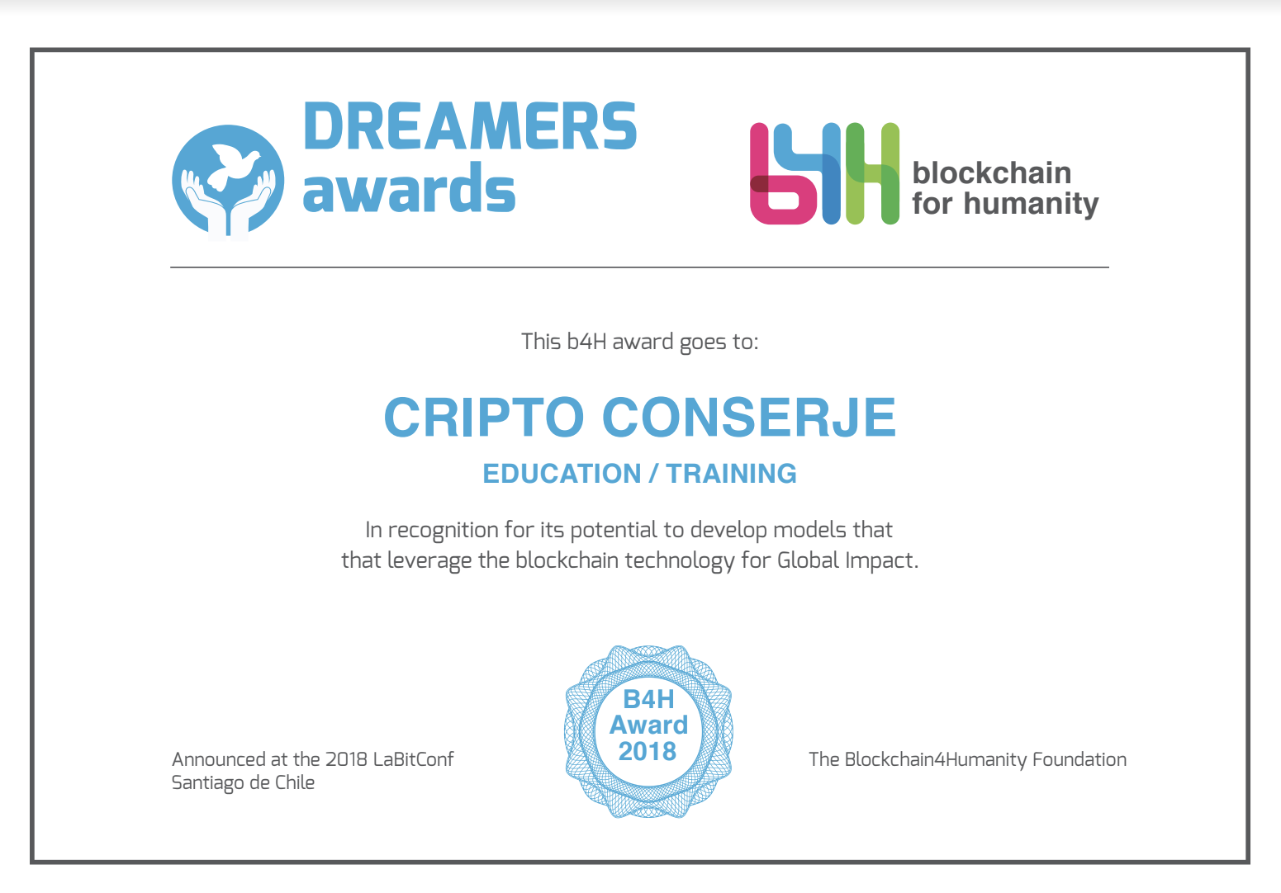
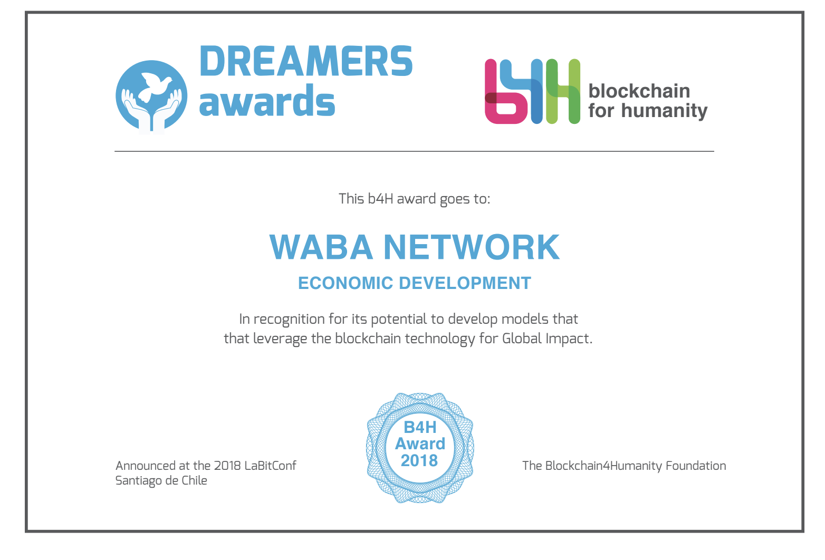
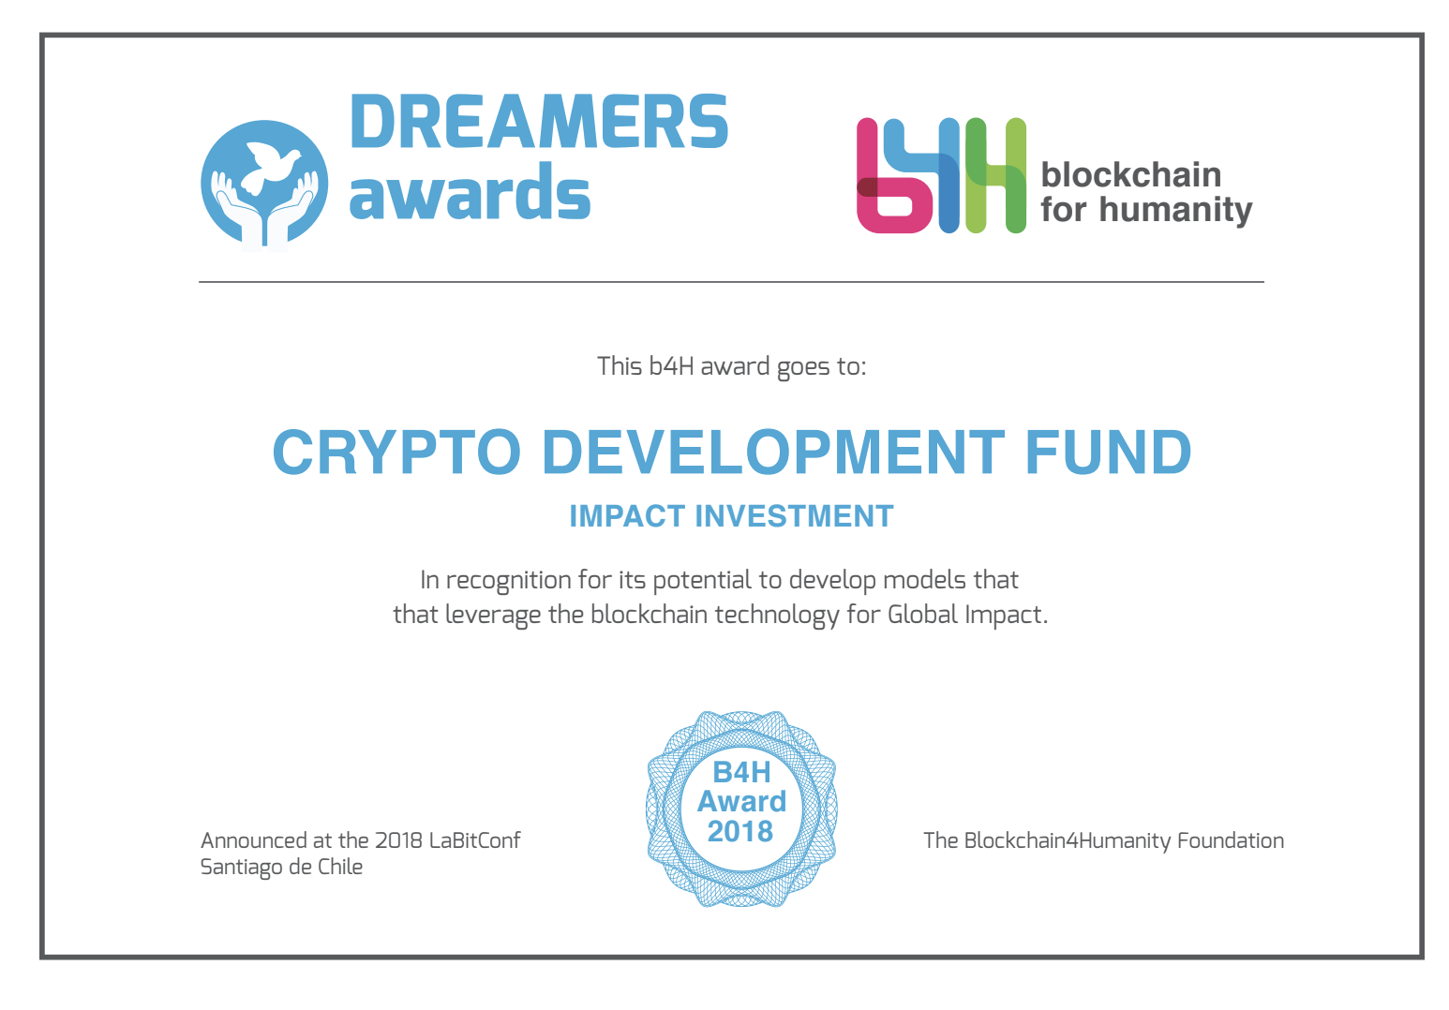
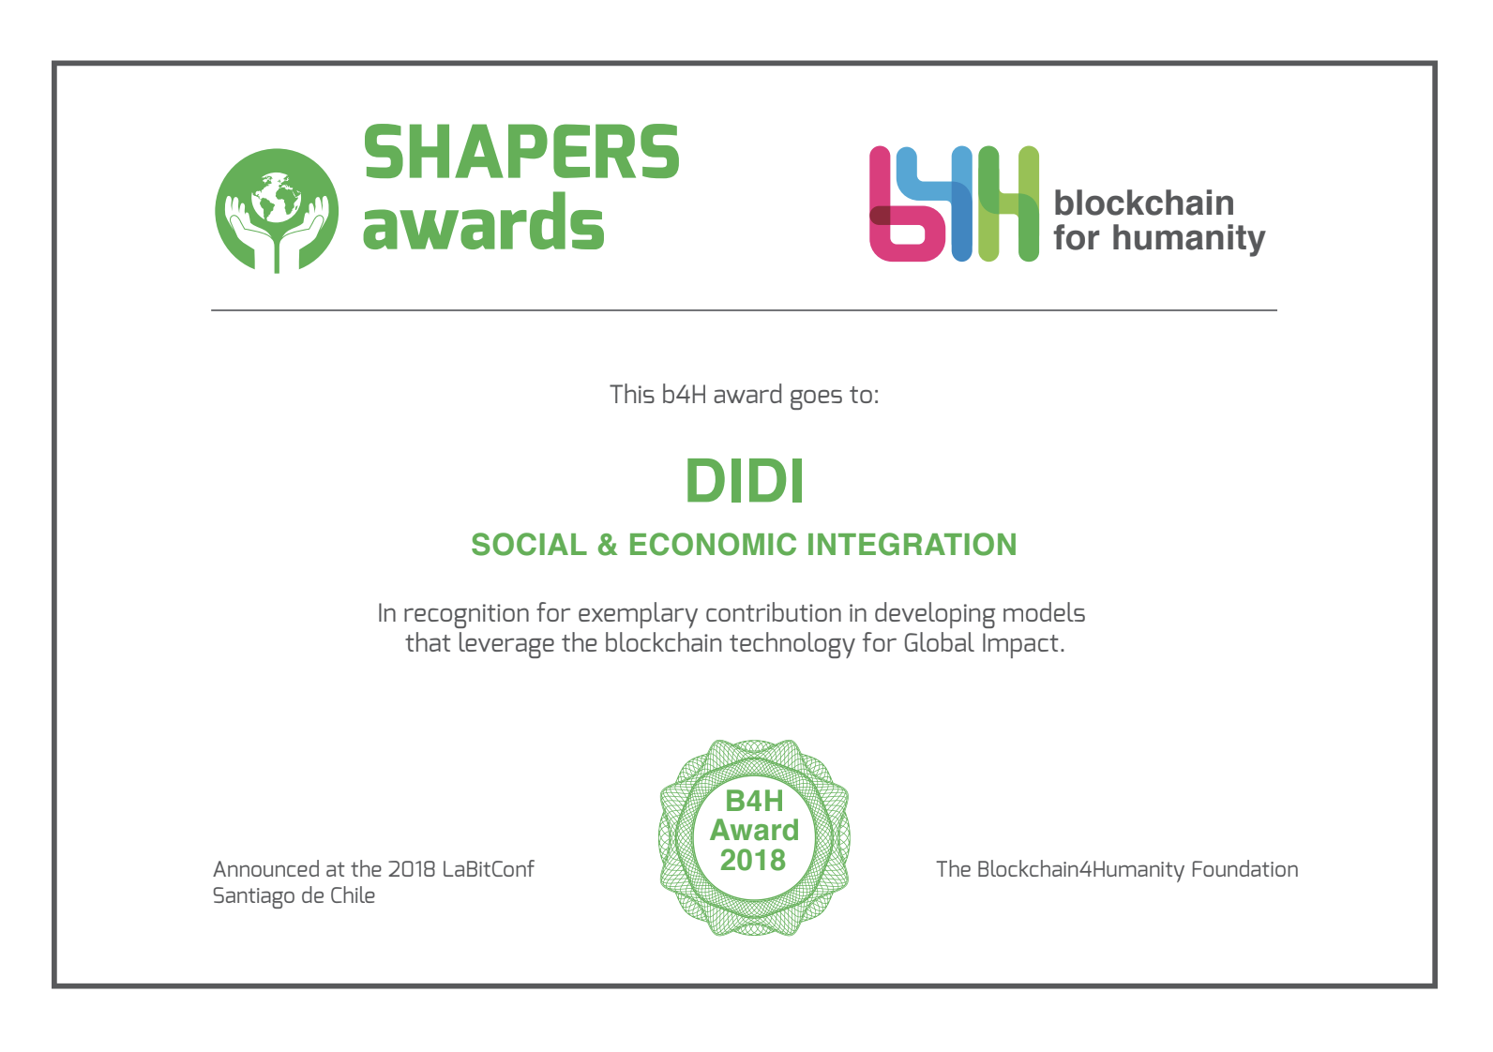
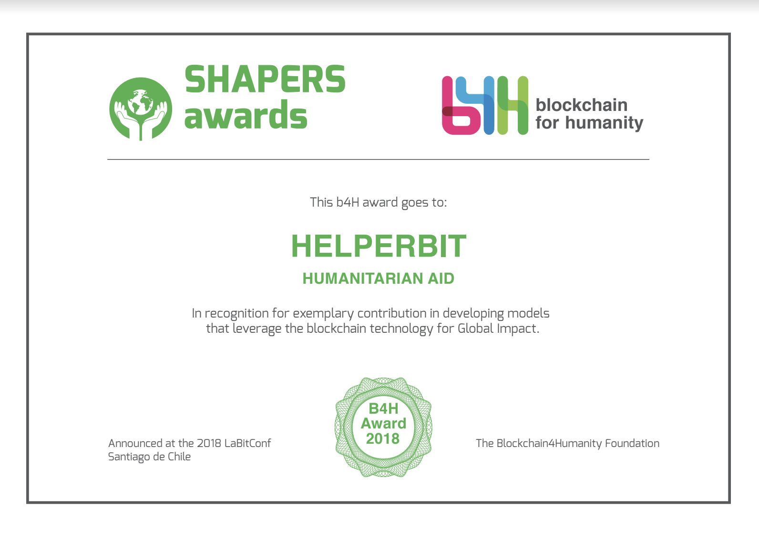
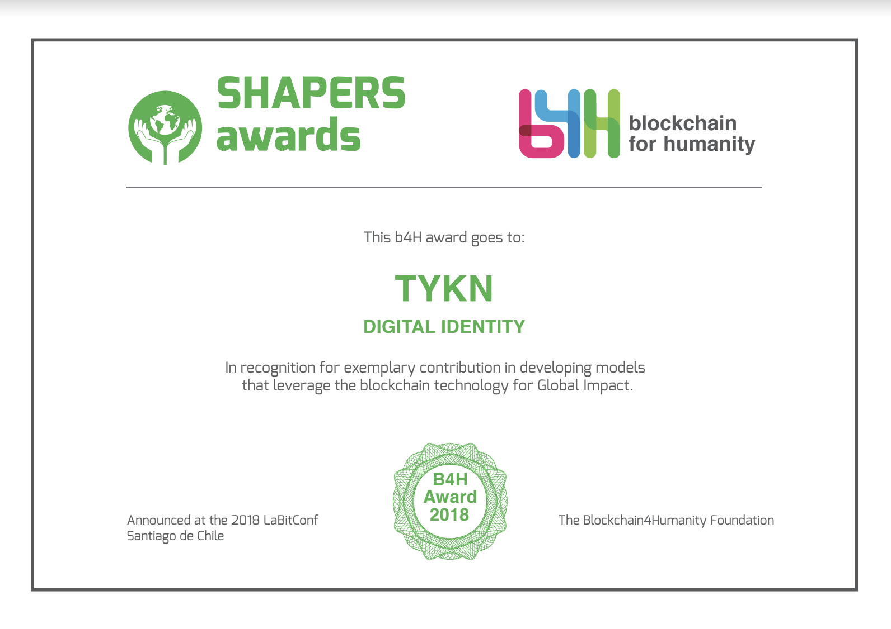
4. b4H Awards
Notes:
“We encourage the use of the blockchain technology to develop socio-economic impact solutions within emerging markets.”
Through our b4H CATALIZING PROGRAM and our COALITION 4 GOOD Blockchain Ecosystem of mentors, partners and sponsors, donors; We ignite the use of the technology to reduce gaps in society and build a more equitable life for many.

Slide 6
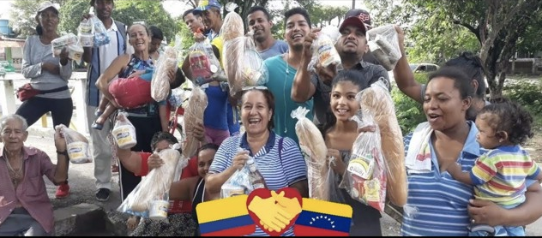
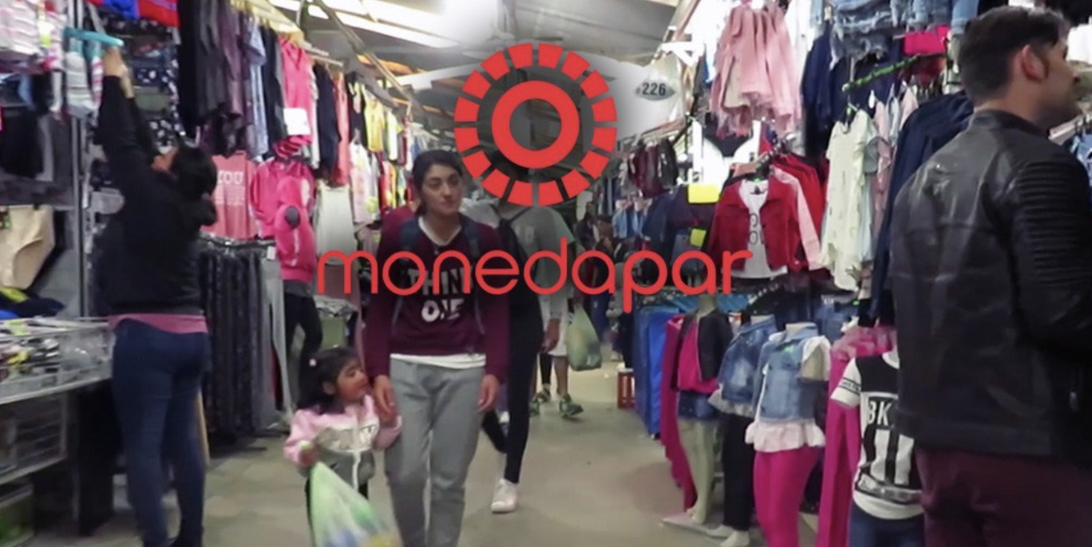
4. b4H Awards
DREAMERS AWARD
Notes:
“We encourage the use of the blockchain technology to develop socio-economic impact solutions within emerging markets.”
Through our b4H CATALIZING PROGRAM and our COALITION 4 GOOD Blockchain Ecosystem of mentors, partners and sponsors, donors; We ignite the use of the technology to reduce gaps in society and build a more equitable life for many.

Slide 7
4. b4H Awards
Notes:
“We encourage the use of the blockchain technology to develop socio-economic impact solutions within emerging markets.”
Through our b4H CATALIZING PROGRAM and our COALITION 4 GOOD Blockchain Ecosystem of mentors, partners and sponsors, donors; We ignite the use of the technology to reduce gaps in society and build a more equitable life for many.

Slide 8
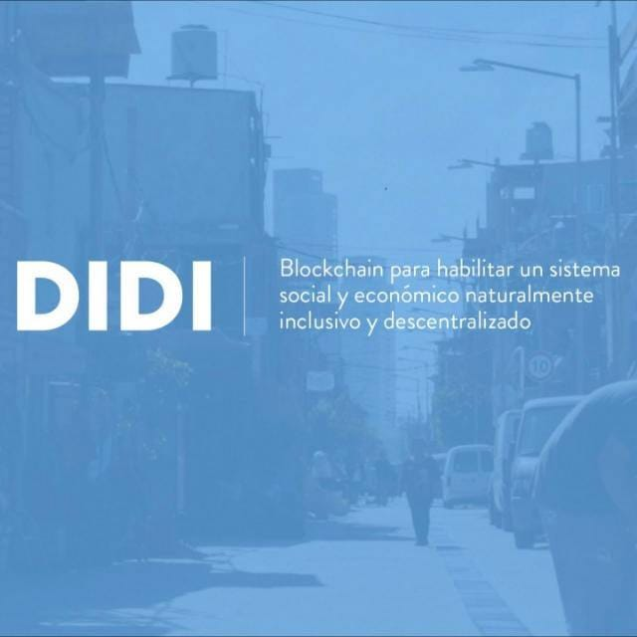
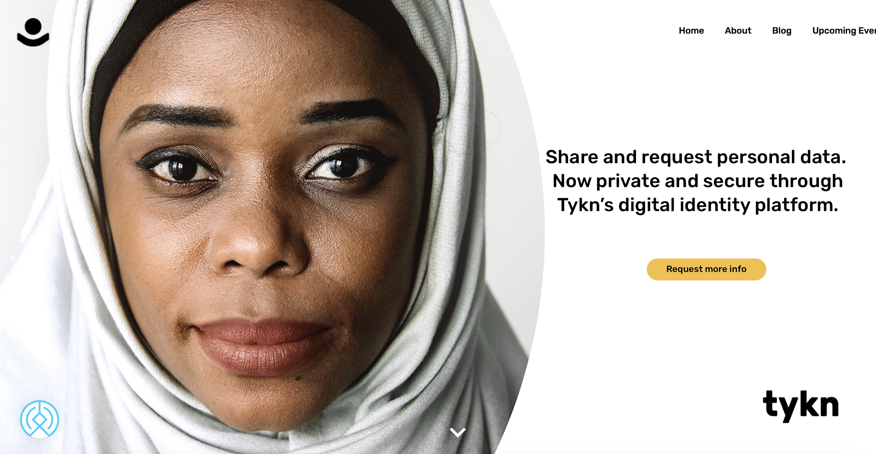
4. b4H Awards
SHAPERS AWARD
Notes:
“We encourage the use of the blockchain technology to develop socio-economic impact solutions within emerging markets.”
Through our b4H CATALIZING PROGRAM and our COALITION 4 GOOD Blockchain Ecosystem of mentors, partners and sponsors, donors; We ignite the use of the technology to reduce gaps in society and build a more equitable life for many.

Slide 9
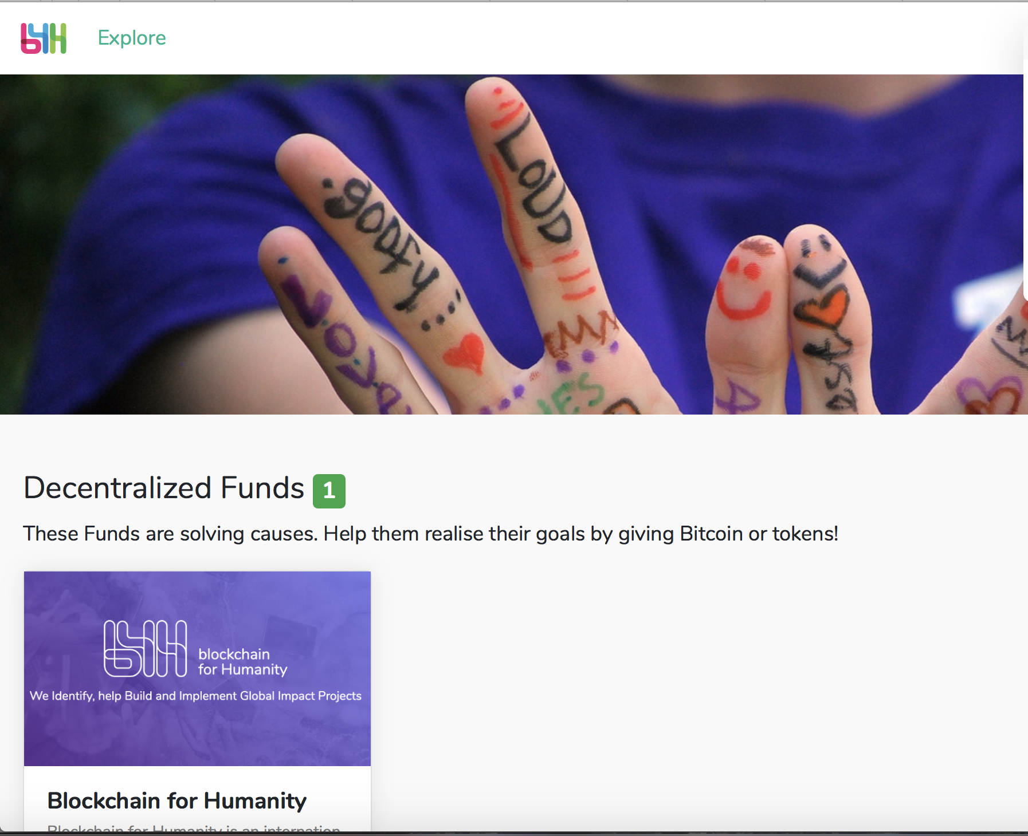
5. b4H dApp
Open-source application that keeps track of funds in a transparent way.
We offer it as ‘white-label’ for any non-profit organization.
Milestone based fund distribution, only released upon milestone completion
Recommended for institutions and organizations managing public or charitable funds (NGOs, Charities, Government, Universities, Associations, etc. )
Notes:
“We encourage the use of the blockchain technology to develop socio-economic impact solutions within emerging markets.”
Through our b4H CATALIZING PROGRAM and our COALITION 4 GOOD Blockchain Ecosystem of mentors, partners and sponsors, donors; We ignite the use of the technology to reduce gaps in society and build a more equitable life for many.

Slide 10
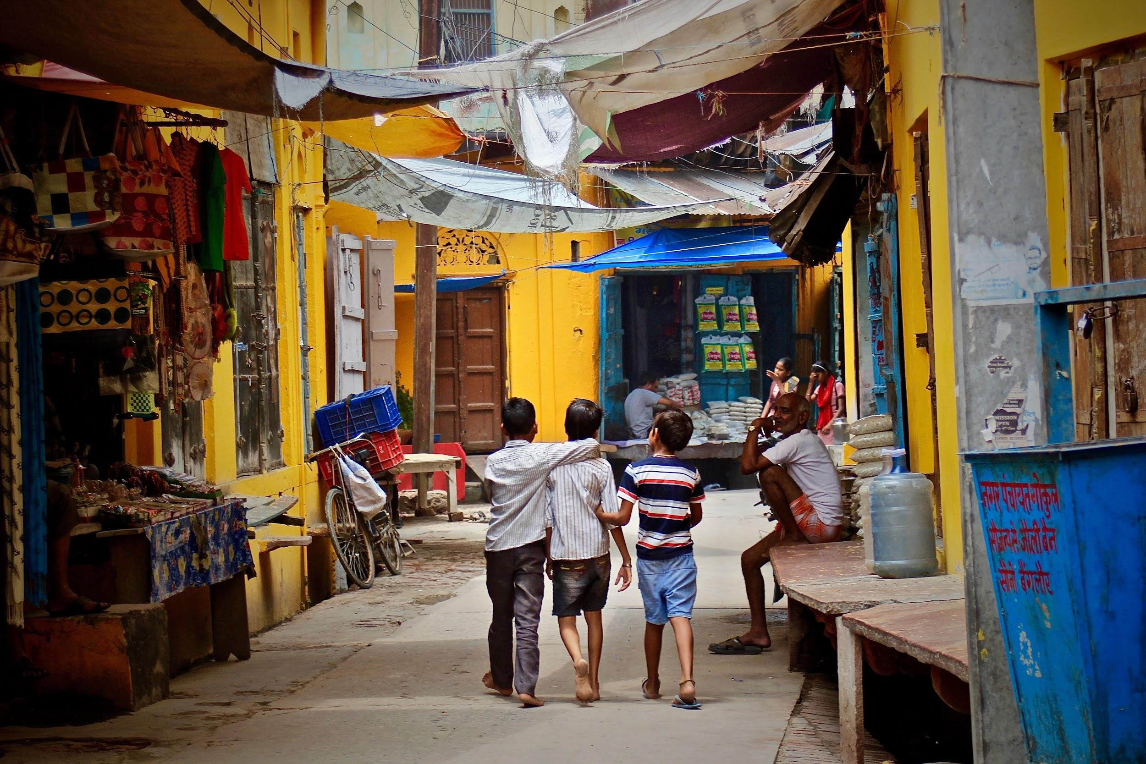
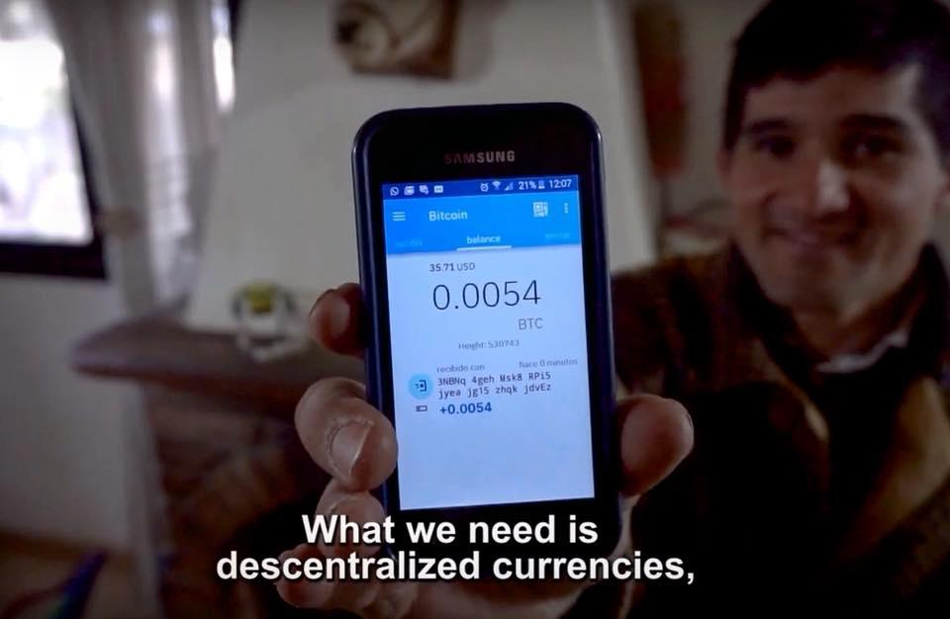
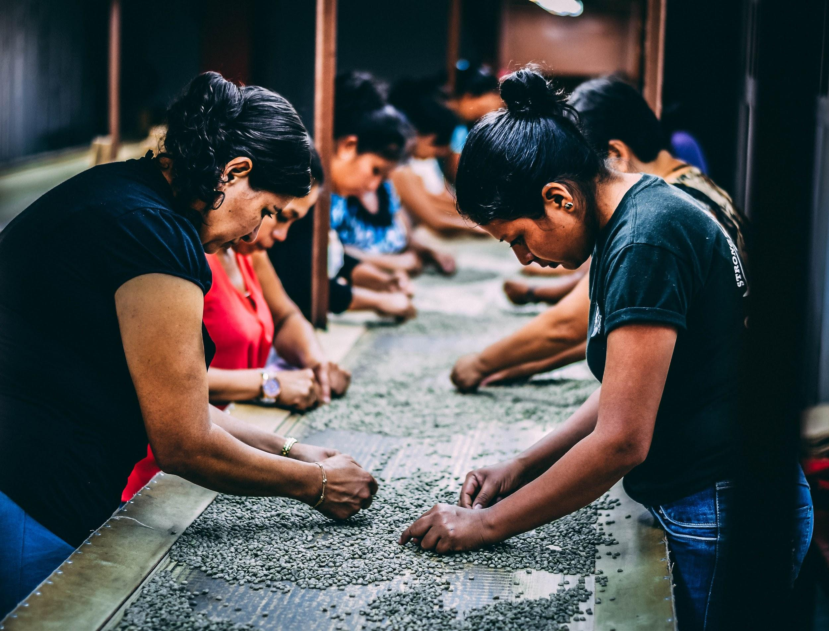
5. Use Cases We Support
Social Inclusion/Governance
Digital certifications/Proof of ownership
Transparency in Governmental models
Social Accountability
Medical history on blockchain
Traceability in supply value chain
Financial Inclusion
Micro Lending
Human Aid/Human Rights
Self-Sovereign Digital identity
Agro-Tech
Notes:
“We encourage the use of the blockchain technology to develop socio-economic impact solutions within emerging markets.”
Through our b4H CATALIZING PROGRAM and our COALITION 4 GOOD Blockchain Ecosystem of mentors, partners and sponsors, donors; We ignite the use of the technology to reduce gaps in society and build a more equitable life for many.

Slide 11
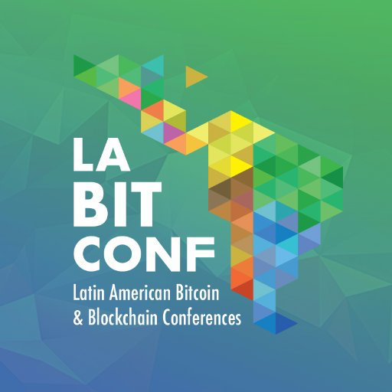
7. Coalition4GOOD Ecosystem Partners

Slide 12
8. Join the #Coalition4GOOD
You are welcome to join the 4GOOD movement!
Entrepreneurial Project - Submit your application today, pre-selection starts September 2019.
b4H Angel - We are seeking regional Angels that can help spread the world and inspire innovative and impactful projects to join the Coalitions4GOOD.
Mentor - Use your knowledge and experience to mentor positive impact projects.
Advisor - Find projects that match your interest and use your network to support them.
Volunteer - Join the b4H Contributors team, we welcome content creators, social media wizards, graphic designers and social hackers.
Sponsor - Fundraising is always needed to propel awesome ideas, your contribution makes a difference.
Notes:
“We encourage the use of the blockchain technology to develop socio-economic impact solutions within emerging markets.”
Through our b4H CATALIZING PROGRAM and our COALITION 4 GOOD Blockchain Ecosystem of mentors, partners and sponsors, donors; We ignite the use of the technology to reduce gaps in society and build a more equitable life for many.

Slide 13
Contact Coordinates
www.b4h.world
Blockchain4Humanity
@b4_humanity
https://t.me/blockchain4humanity
hello@b4h.world

